Slide 1
Eye-tracking demonstrates
the value of newsbrands’
quality digital environment

Slide 2





Digital newsbrands: a quality environment for ads
Double the viewing time
per page than non-newsbrand sites
60% higher viewable time
for ads
Ad viewing
2½ times more likely on a newsbrand site
Newsbrand digital readers 70% more likely to see MPUs with 30 seconds viewable time
Average ad dwell time 30% higher on newsbrand sites
Newsbrands = theguardian.com, telegraph.co.uk, independent.co.uk, indy100.independent.co.uk, thetimes.co.uk, ft.com, dailymail.co.uk, mirror.co.uk, standard.co.uk, thesun.co.uk, dailystar.co.uk, metro.co.uk, express.co.uk, manchestereveningnews.co.uk, walesonline.co.uk, dailyrecord.co.uk. Others = msn.com, uk.yahoo.com, digitalspy.com, engadget.com, mashable.com, ibtimes.co.uk, thisismoney.co.uk, bleacherreport.com, pistonheads.com, weather.com, howtogeek.com, theregister.co.uk, sportinglife.com, channel4.com, itv.com, channel5.com, marieclaire.co.uk, timeout.com, trustedreviews.com, goodtoknow.co.uk, bbcgoodfood.com, pcadvisor.co.uk, nme.com, autoexpress.co.uk, forbes.com, radiotimes.com

Slide 3
Newsbrand sites achieve higher ad viewing
Page visits last twice as long
Which increases viewable time for ads
Viewability is similar across newsbrand and other popular sites
(IAB definition)
But viewing of ads is 2 ½ times more likely on newsbrand sites
Time on page - seconds
Viewable time - seconds
Viewable %
Viewed %
Newsbrands = theguardian.com, telegraph.co.uk, independent.co.uk, indy100.independent.co.uk, thetimes.co.uk, ft.com, dailymail.co.uk, mirror.co.uk, standard.co.uk, thesun.co.uk, dailystar.co.uk, metro.co.uk, express.co.uk, manchestereveningnews.co.uk, walesonline.co.uk, dailyrecord.co.uk. Others = msn.com, uk.yahoo.com, digitalspy.com, engadget.com, mashable.com, ibtimes.co.uk, thisismoney.co.uk, bleacherreport.com, pistonheads.com, weather.com, howtogeek.com, theregister.co.uk, sportinglife.com, channel4.com, itv.com, channel5.com, marieclaire.co.uk, timeout.com, trustedreviews.com, goodtoknow.co.uk, bbcgoodfood.com, pcadvisor.co.uk, nme.com, autoexpress.co.uk, forbes.com, radiotimes.com

Slide 4
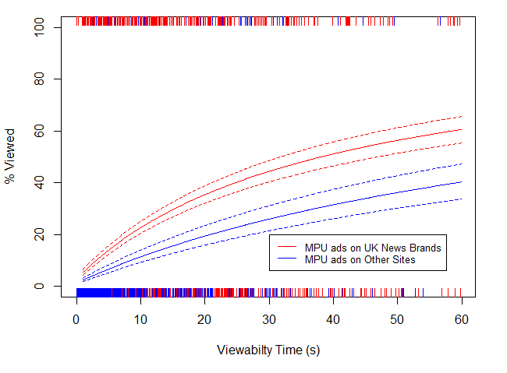
Time on newsbrand sites is more valuable to advertisers
Newsbrands convert viewable time to actual ad views more effectively
MPUs with 30 seconds viewable time are seen 44% of the time on newsbrands site, but just 26% elsewhere – a 70% uplift
% Viewed MPU | 10” | 20” | 30” | 40” | 50” | 60”
Newsbrands | 23% | 35% | 44% | 51% | 56% | 61%
Other sites | 11% | 19% | 26% | 31% | 36% | 40%
Newsbrands = theguardian.com, telegraph.co.uk, independent.co.uk, iindy100.independent.co.uk, thetimes.co.uk, ft.com, dailymail.co.uk, mirror.co.uk, standard.co.uk, thesun.co.uk, dailystar.co.uk, metro.co.uk, express.co.uk, manchestereveningnews.co.uk, walesonline.co.uk, dailyrecord.co.uk. Others = msn.com, uk.yahoo.com, digitalspy.com, engadget.com, mashable.com, ibtimes.co.uk, thisismoney.co.uk, bleacherreport.com, pistonheads.com, weather.com, howtogeek.com, theregister.co.uk, sportinglife.com, channel4.com, itv.com, channel5.com, marieclaire.co.uk, timeout.com, trustedreviews.com, goodtoknow.co.uk, bbcgoodfood.com, pcadvisor.co.uk, nme.com, autoexpress.co.uk, forbes.com, radiotimes.com

Slide 5
Digital newsbrands: a quality environment for ads
  46% higher dwell time on site
  More viewable time
  30% longer average dwell time per ad
Online newsbrands: Mirror.co.uk, Metro.co.uk, Thesun.co.uk, Thetimes.co.uk, Dailymail.co.uk, Telegraph.co.uk, Theguardian.com, Independent.co.uk
Non-newsbrands: msn.com, uk.yahoo.com, digitalspy.com, engadget.com, mashable.com, ibtimes.co.uk, thisismoney.co.uk, bleacherreport.com, pistonheads.com, howtogeek.com, theregister.co.uk, sportinglife.com, marieclaire.co.uk, timeout.com, trustedreviews.com, goodtoknow.co.uk, bbcgoodfood.com, pcadvisor.co.uk, nme.com, autoexpress.co.uk, forbes.com, radiotimes.com

Slide 6
Black Friday event boosts time spent on ads in digital newsbrands by 20%
Readership per day
Av. time spent on all ads per visitor per day
Total time on ads across all publications per day (hours)
Black Friday uplift
5,527,333
1.24 secs
1,903 hours
Normal
+20%
5,527,333
1.48 secs
2,275 hours
Black Friday
Readership per day figures from NRS
Average time spent on all ads per visitor per day on a normal day is estimated using Lumen’s econometric model

Slide 7
Christmas period increases time spent on digital newsbrand ads by 5%
Christmas digital increase smaller – possibly due to delivery times etc
But digital newsbrands continue to outperform other sites
Readership per day
Av. time spent on all ads per visitor per day
Total time on ads across all publications per day (hours)
Xmas period uplift
4,010,561
1.24 secs
1,382 hours
Normal
+5%
Digital
4,010,561
1.31 secs
1,454 hours
Xmas period
Readership per day figures from NRS
Average time spent on all ads per visitor per day on a normal day is estimated using Lumen’s econometric model

Slide 8

Billboard – 29/11/2016
Dwell time 8% above digital newsbrand billboard norm

